Slide 1
Network Layer (Routing)

Slide 2





Network layer functions - 1
application
transport
network
data link
physical
transport packet from sending to receiving hosts
network layer protocols in every host, router
network
data link
physical
network
data link
physical
network
data link
physical
network
data link
physical
network
data link
physical
network
data link
physical
network
data link
physical
network
data link
physical
application
transport
network
data link
physical

Slide 3
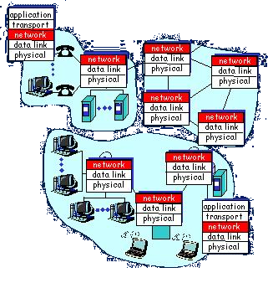
Network layer functions - 2
three important functions:
path determination: route taken by packets from source to dest. Routing algorithms
Switching (forwarding): move packets from router’s input to appropriate router output
call setup: (optional) some network architectures require router call setup along path before data flows

Slide 4
Network service model
Q: What service model for “channel” transporting packets from sender to receiver?
guaranteed bandwidth?
preservation of inter-packet timing (no jitter)?
loss-free delivery?
in-order delivery?
congestion feedback to sender?
The most important
abstraction provided
by network layer:
?
?
virtual circuit
or
datagram?
?
service abstraction

Slide 5
Datagram networks: the Internet model - 1
no call setup at network layer
routers: no state about end-to-end connections
  no network-level concept of “connection”
packets typically routed using destination host ID
  packets between same source-dest pair may take different paths

Slide 6
Datagram networks: the Internet model - 2
application
transport
network
data link
physical
application
transport
network
data link
physical
1. Send data
2. Receive data

Slide 7
Routing
Routing protocol
Goal: determine “good” path
(sequence of routers) thru
network from source to dest.
5
B
3
C
2
5
A
2
1
F
Graph abstraction for routing algorithms:
graph nodes are routers
graph edges are physical links
  link cost: delay, $ cost, or congestion level
3
1
2
D
E
1
“good” path:
  typically means minimum cost path
  other def’s possible

Slide 8
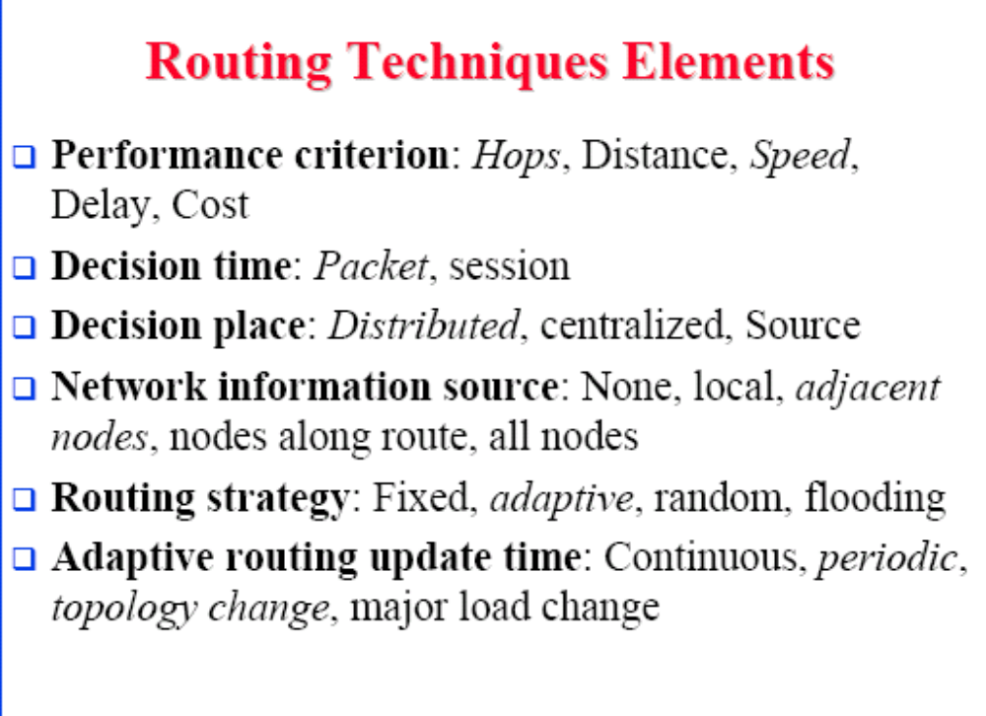

Slide 9
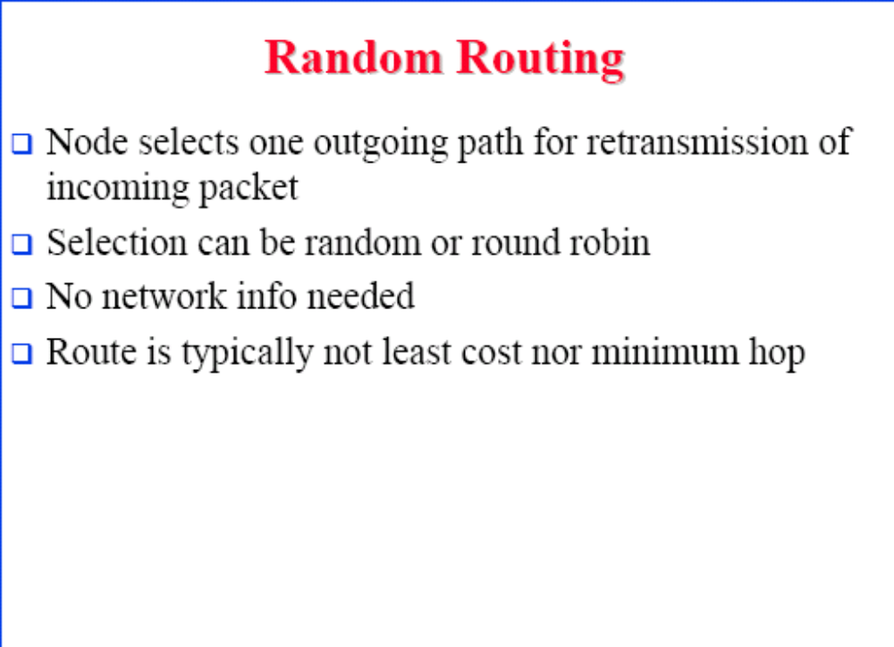

Slide 10
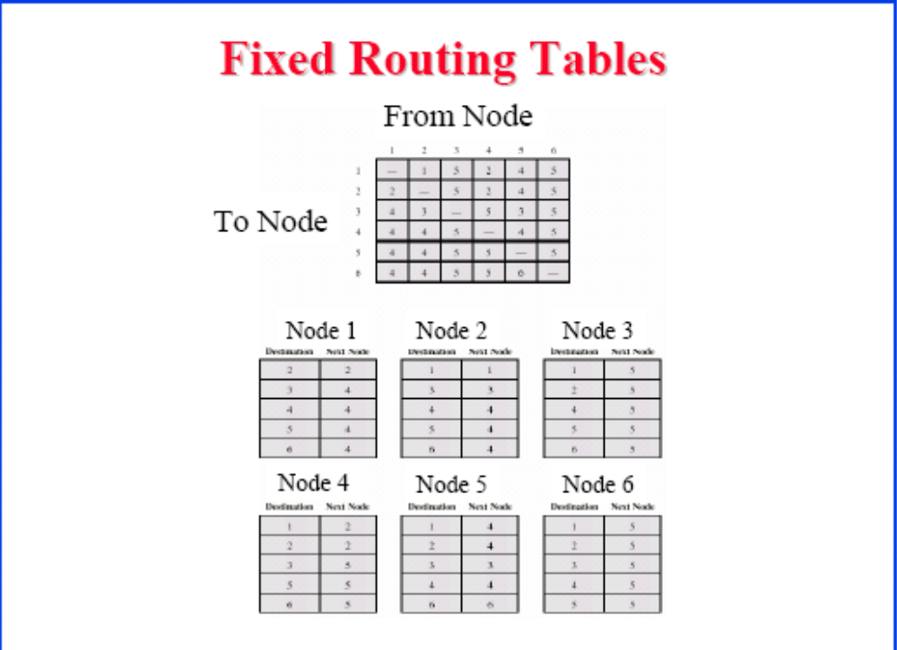

Slide 11
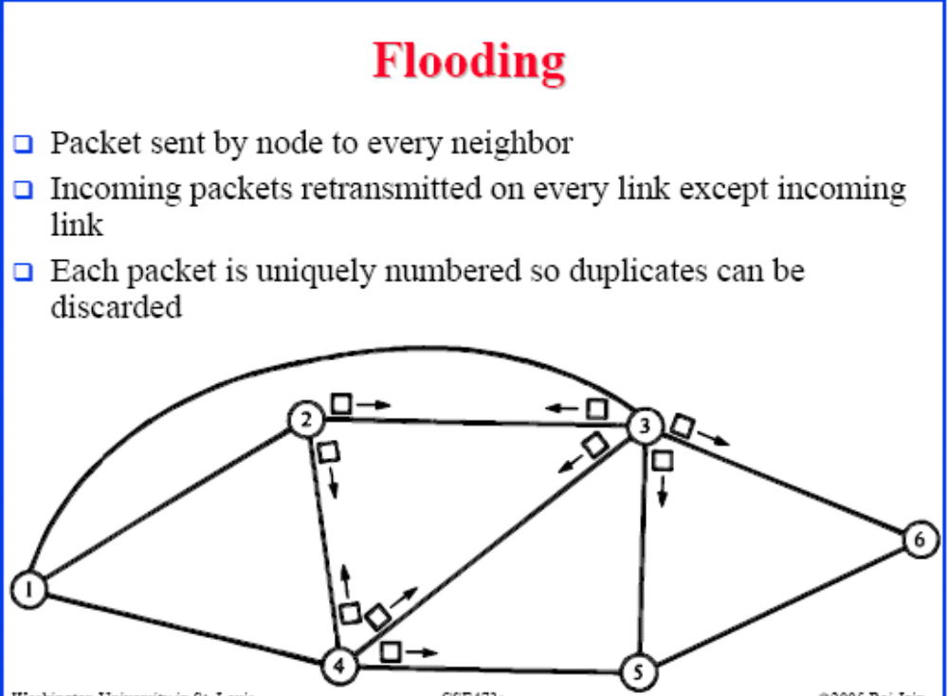

Slide 12
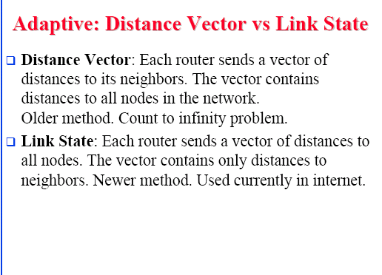

Slide 13
Routing Algorithm classification - 1
Global or decentralized information?
Global:
  all routers have complete topology, link cost info
  “link state” algorithms
Decentralized:
  router knows physically-connected neighbors, link costs to neighbors
  iterative process of computation, exchange of partial info with neighbors
  “distance vector” algorithms

Slide 14
Routing Algorithm classification - 2
Static or dynamic?
Static:
routes change slowly over time
Dynamic:
routes change more quickly
  periodic update
  in response to link cost changes

Slide 15
A Link-State Routing Algorithm - 1
Dijkstra’s algorithm
net topology, link costs known to all nodes
  accomplished via “link state broadcast”
  all nodes have same info
computes least cost paths from one node (‘source”) to all other nodes
  gives routing table for that node
  iterative: after k iterations, know least cost path to k dest.’s

Slide 16
A Link-State Routing Algorithm - 2
Notation:
c(i,j): link cost from node i to j. cost infinite if not direct neighbors
D(v): current value of cost of path from source to dest. V
p(v): predecessor node (neighbor of v) along path from source to v
N: set of nodes whose least cost path definitively known

Slide 17
Dijkstra’s algorithm: example
Step
0
1
2
3
4
5
start N
A
AD
ADE
ADEB
ADEBC
ADEBCF
D(B),p(B)
2,A
2,A
2,A
D(C),p(C)
5,A
4,D
3,E
3,E
D(D),p(D)
1,A
D(E),p(E)
infinity
2,D
D(F),p(F)
infinity
infinity
4,E
4,E
4,E
5
B
3
C
2
5
A
2
1
F
3
1
2
D
E
1

Slide 18
Dijsktra’s Algorithm
1 Initialization:
2 N = {A}
3 for all nodes v
4 if v adjacent to A
5 then D(v) = c(A,v)
6 else D(v) = infty
7
8 Loop
9 find w not in N such that D(w) is a minimum
10 add w to N
11 update D(v) for all v adjacent to w and not in N:
12 D(v) = min( D(v), D(w) + c(w,v) )
13 /* new cost to v is either old cost to v or known
14 shortest path cost to w plus cost from w to v */
15 until all nodes in N

Slide 19
Dijkstra’s algorithm: discussion
Algorithm complexity: n nodes
each iteration: need to check all nodes, w, not in N
n*(n+1)/2 comparisons: O(n**2)
more efficient implementations possible: O(nlogn)
Oscillations possible:
e.g., link cost = amount of carried traffic

Slide 20
Distance Vector Routing Algorithm - 1
iterative:
continues until no nodes exchange info.
self-terminating: no “signal” to stop
asynchronous:
nodes need not exchange info/iterate in lock step!
distributed:
each node communicates only with directly-attached neighbors

Slide 21
Distance Vector Routing Algorithm - 2
Distance Table data structure
each node has its own
row for each possible destination
column for each directly-attached neighbor to node
example: in node X, for dest. Y via neighbor Z:
distance from X to
Y, via Z as next hop
X
=
D (Y,Z)
Z
=
c(X,Z) + min {D (Y,w)}
w

Slide 22
Distance table: example
1
cost to destination via
B
C
E
7
D ()
A
B
C
D
A
1
7
6
4
B
14
8
9
11
D
5
5
4
2
A
8
2
1
E
D
2
E
D
D (C,D)
=
c(E,D) + min {D (C,w)}
w
destination
=
2+2 = 4
E
D
D (A,D)
=
c(E,D) + min {D (A,w)}
w
=
2+3 = 5
loop!
E
B
D (A,B)
=
c(E,B) + min {D (A,w)}
w
=
8+6 = 14
loop!

Slide 23
Distance table gives routing table
cost to destination via
Outgoing link
to use, cost
E
D ()
A
B
C
D
A
1
7
6
4
B
14
8
9
11
D
5
5
4
2
A
B
C
D
A,1
D,5
D,4
D,4
destination
destination
Distance table
Routing table

Slide 24
Distance Vector Routing: overview - 1
Iterative, asynchronous: each local iteration caused by:
local link cost change
message from neighbor: its least cost path change from neighbor
Distributed:
each node notifies neighbors only when its least cost path to any destination changes
  neighbors then notify their neighbors if necessary

Slide 25
Distance Vector Routing: overview - 2
Each node:
wait for (change in local link cost of msg from neighbor)
recompute distance table
if least cost path to any dest has changed, notify neighbors

Slide 26
Distance Vector Algorithm - 1
At all nodes, X:
1 Initialization:
2 for all adjacent nodes v:
3 D (*,v) = infty /* the * operator means "for all rows" */
4 D (v,v) = c(X,v)
5 for all destinations, y
6 send min D (y,w) to each neighbor /* w over all X's neighbors */
X
X
X
w

Slide 27
Distance Vector Algorithm - 2
8 loop
9 wait (until I see a link cost change to neighbor V
10 or until I receive update from neighbor V)
11
12 if (c(X,V) changes by d)
13 /* change cost to all dest's via neighbor v by d */
14 /* note: d could be positive or negative */
15 for all destinations y: D (y,V) = D (y,V) + d
16
17 else if (update received from V wrt destination Y)
18 /* shortest path from V to some Y has changed */
19 /* V has sent a new value for its min DV(Y,w) */
20 /* call this received new value is "newval" */
21 for the single destination y: D (Y,V) = c(X,V) + newval
22
23 if we have a new min D (Y,w)for any destination Y
24 send new value of min D (Y,w) to all neighbors
25
26 forever
X
X
w
X
X
w
X
w

Slide 28
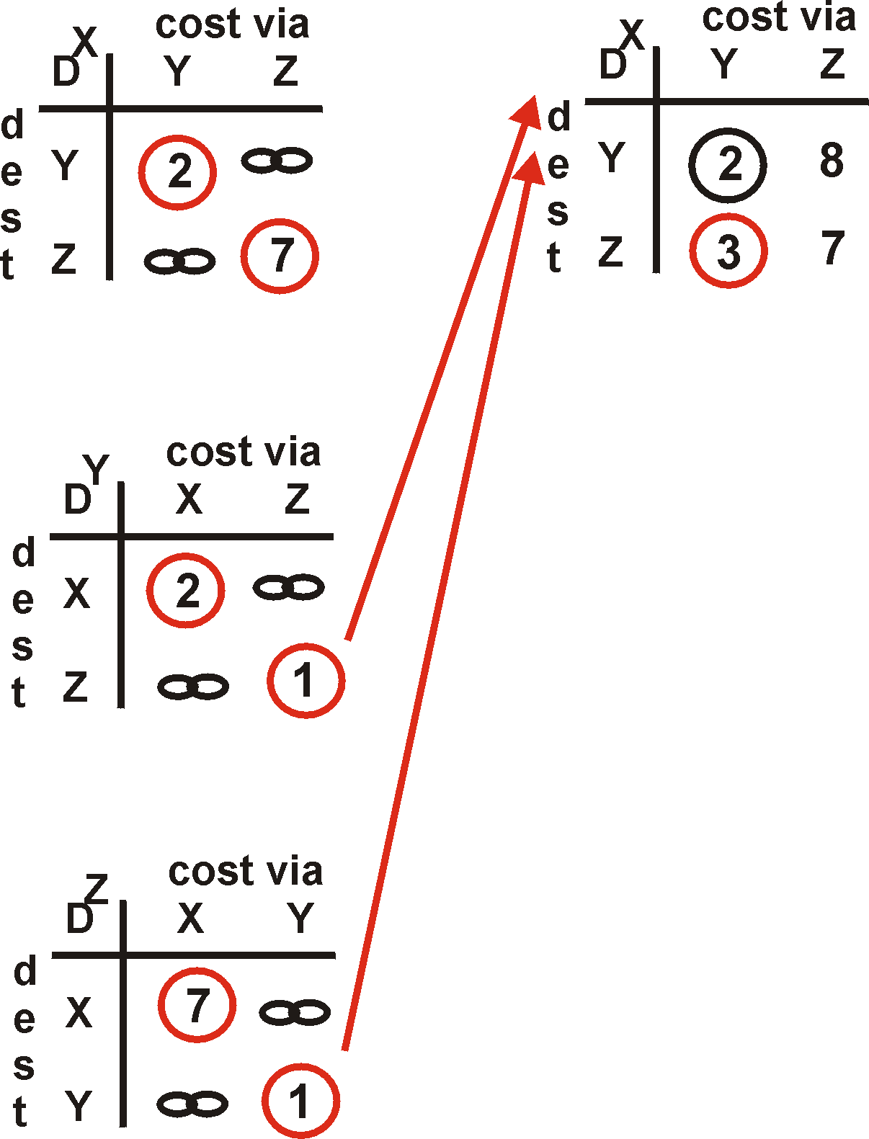
Distance Vector Algorithm: example - 1
Y
2
1
X
Z
X
Z
7
D (Y,Z)
=
c(X,Z) + min {D (Y,w)}
w
=
7+1 = 8
X
Y
D (Z,Y)
=
c(X,Y) + min {D (Z,w)}
w
=
2+1 = 3

Slide 29
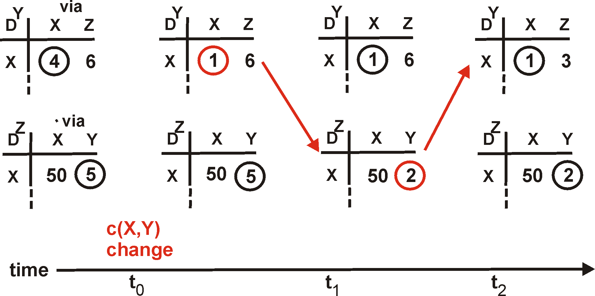
Distance Vector: link cost changes - 1
Link cost changes:
node detects local link cost change
updates distance table (line 15)
if cost change in least cost path, notify neighbors (lines 23,24)
1
Y
4
1
X
Z
50
algorithm
terminates
“good
news
travels
fast”

Slide 30
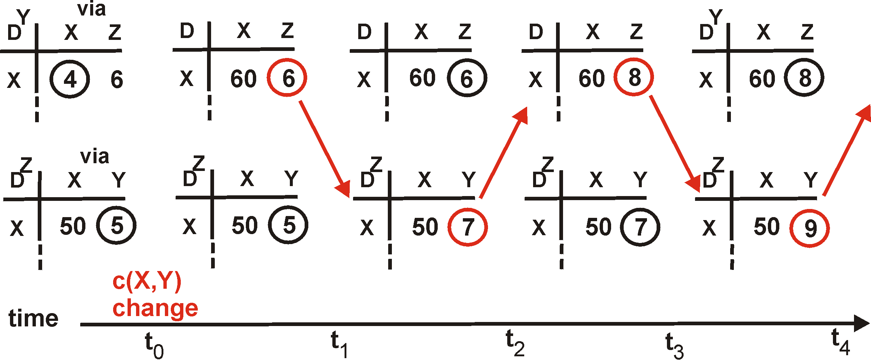
Distance Vector: link cost changes - 2
Link cost changes:
good news travels fast
bad news travels slow - “count to infinity” problem!
60
Y
4
1
X
Z
50
algorithm
continues
on!

Slide 31
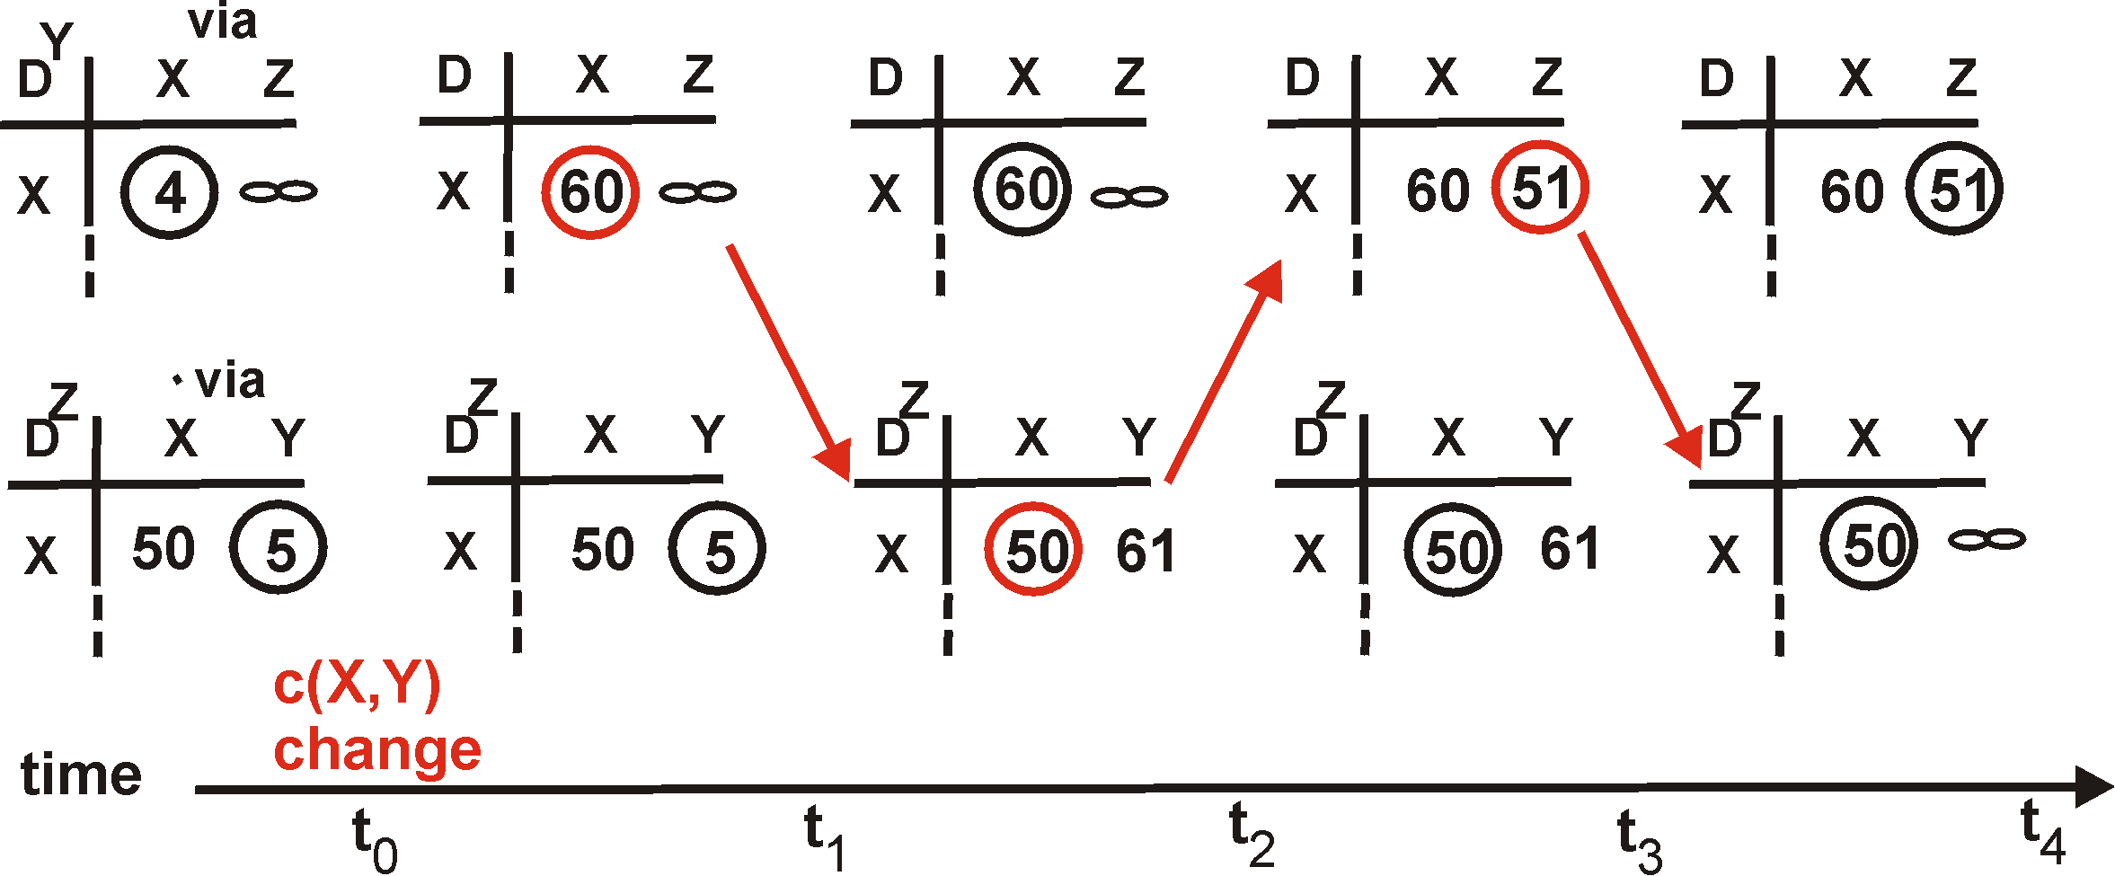
Distance Vector: poisoned reverse
If Z routes through Y to get to X :
Z tells Y its (Z’s) distance to X is infinite (so Y won’t route to X via Z)
will this completely solve count to infinity problem?
60
Y
4
1
X
Z
50
algorithm
terminates

Slide 32
Comparison of
LS and DV algorithms - 1
Message complexity
LS: with n nodes, E links, O(nE) msgs sent each
DV: exchange between neighbors only
  convergence time varies
Speed of Convergence
LS: O(n**2) algorithm requires O(nE) msgs
  may have oscillations
DV: convergence time varies
  may be routing loops
  count-to-infinity problem

Slide 33
Comparison of
LS and DV algorithms - 1
Robustness: what happens if router malfunctions?
LS:
  node can advertise incorrect link cost
  each node computes only its own table
DV:
  DV node can advertise incorrect path cost
  each node’s table used by others
    error propagate thru network

Slide 34
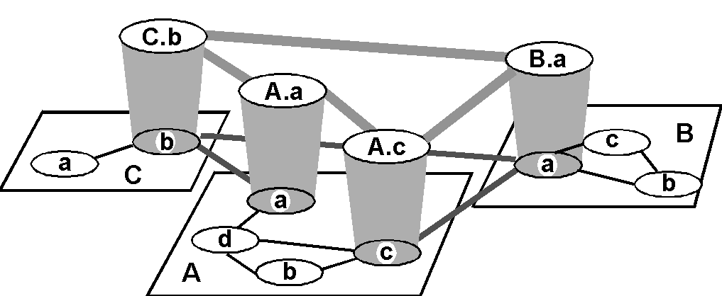
Internet AS Hierarchy
Intra-AS border (exterior gateway) routers
Inter-AS interior (gateway) routers

Slide 35
Intra-AS Routing
Also known as Interior Gateway Protocols (IGP)
Most common IGPs:
  RIP: Routing Information Protocol
  OSPF: Open Shortest Path First
  IGRP: Interior Gateway Routing Protocol (Cisco propr.)

Slide 36
RIP
(Routing Information Protocol) - 1
Distance vector algorithm
Included in BSD-UNIX Distribution in 1982
Distance metric: # of hops (max = 15 hops)
Distance vectors: exchanged every 30 sec via Response Message (also called advertisement)
Each advertisement: route to up to 25 destination nets

Slide 37
RIP
(Routing Information Protocol) - 2
z
w
x
y
A
D
B
C
Destination Network Next Router Num. of hops to dest.
w A 2
y B 2
z B 7
x -- 1
…. …. ....
Routing table in D

Slide 38
RIP: Link Failure and Recovery
If no advertisement heard after 180 sec --> neighbor/link declared dead
  routes via neighbor invalidated
  new advertisements sent to neighbors
  neighbors in turn send out new advertisements (if tables changed)
  link failure info quickly propagates to entire net
  poison reverse used to prevent ping-pong loops (infinite distance = 16 hops)

Slide 39
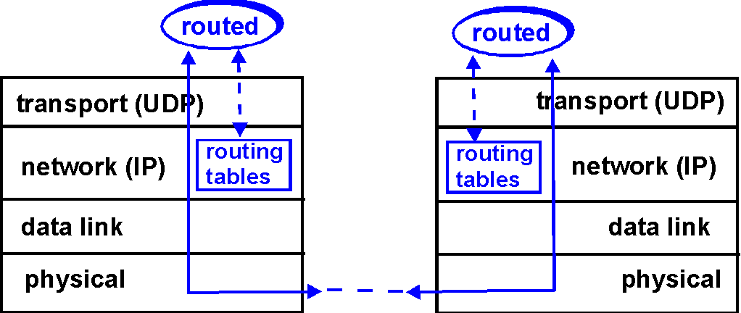
RIP Table processing - 1
RIP routing tables managed by application-level process called route-d (daemon)
advertisements sent in UDP packets, periodically repeated

Slide 40
RIP Table processing - 2
Router: giroflee.eurocom.fr
Destination Gateway Flags Ref Use Interface
-------------------- -------------------- ----- ----- ------ ---------
127.0.0.1 127.0.0.1 UH 0 26492 lo0
192.168.2. 192.168.2.5 U 2 13 fa0
193.55.114. 193.55.114.6 U 3 58503 le0
192.168.3. 192.168.3.5 U 2 25 qaa0
224.0.0.0 193.55.114.6 U 3 0 le0
default 193.55.114.129 UG 0 143454
Three attached class C networks (LANs)
Router only knows routes to attached LANs
Default router used to “go up”
Route multicast address: 224.0.0.0
Loopback interface (for debugging)

Slide 41
OSPF (Open Shortest Path First)
“open”: publicly available
Uses Link State algorithm
  LS packet dissemination
  Topology map at each node
  Route computation using Dijkstra’s algorithm
OSPF advertisement carries one entry per neighbor router
Advertisements disseminated to entire AS (via flooding)

